Slide 1
Data in NARMS dataset downloaded includes isolates from 2002-2019

Slide 2
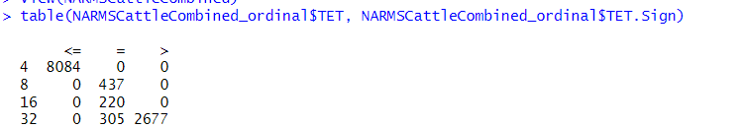

Data looks good
TET Concentration Range Tested:
4-32 (during entire range of dataset)
Change to 64 (double upper limit) to distinguish = 32 (was inhibited by 32) and >32 (still grew in 32)
Tetracycline

Slide 3
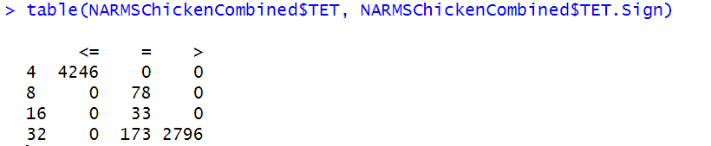
Data looks good
TET Concentration Range Tested:
Same as cattle

Slide 4
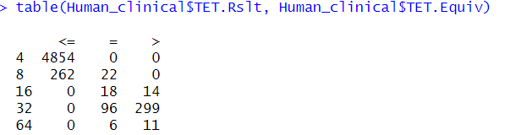
-remove <=8 isolates (262 of them)
-remove >16 isolates (14 of them)
-lump 64 isolates into 32 category

Slide 5
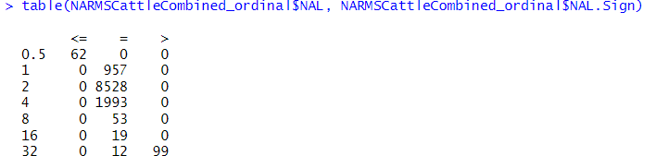

Data looks good
NAL Concentration Range Tested:
0.5-32 (during entire range of dataset)
Change to 64 (double upper limit) to distinguish = 32 (was inhibited by 32) and >32 (still grew in 32)
Nalidixic acid

Slide 6
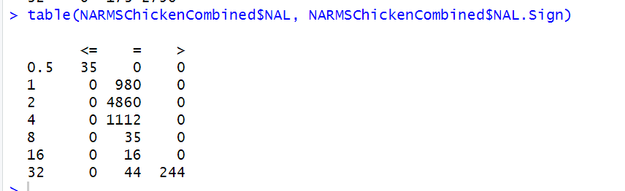
Data looks good
NAL Concentration Range Tested:
Same as cattle

Slide 7
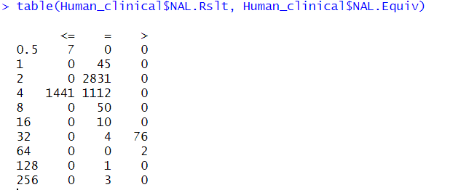
-remove <=4 isolates (1441 of them)
-lump 64, 128, 256 isolates into 32 category

Slide 8

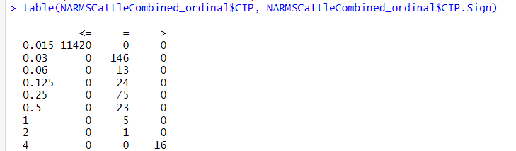
Data looks good
CIP Concentration Range Tested:
0.015-4 (during entire range of dataset)
No longer have the level 4 in the data when > was accounted for
Ciprofloxacin

Slide 9
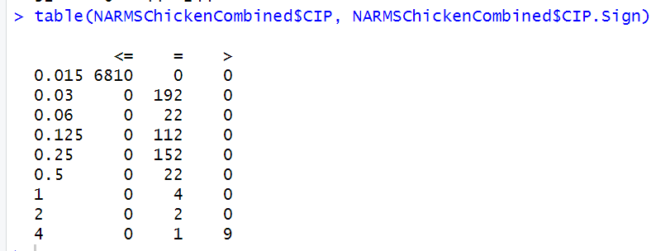
Data looks good
CIP Concentration Range Tested:
Same as cattle
No longer have the level 4 in the data when > was accounted for

Slide 10
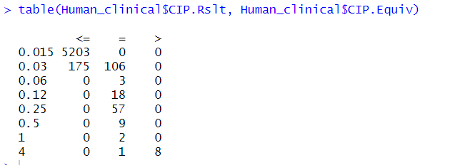
-remove <=0.03 isolates (175 of them)

Slide 11
Florfenicol (FFN) not tested during time range of this dataset

Slide 12
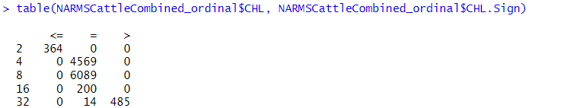


Data looks good
CHL Concentration Range Tested:
2-32 (during entire range of dataset)
Change to 64 (double upper limit) to distinguish = 32 (was inhibited by 32) and >32 (still grew in 32)
Chloramphenicol

Slide 13
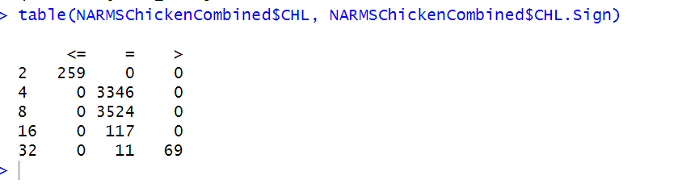
Data looks good
CHL Concentration Range Tested:
Same as cattle

Slide 14
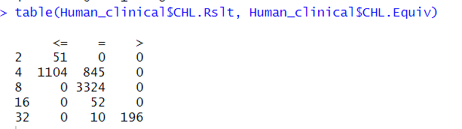
-remove <=4 isolates (1104 of them)

Slide 15
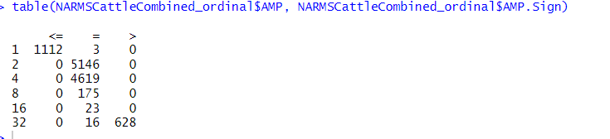


Data looks good
AMP Concentration Range Tested:
1-32 (during entire range of dataset)
Change to 64 (double upper limit) to distinguish = 32 (was inhibited by 32) and >32 (still grew in 32)
Ampicillin

Slide 16
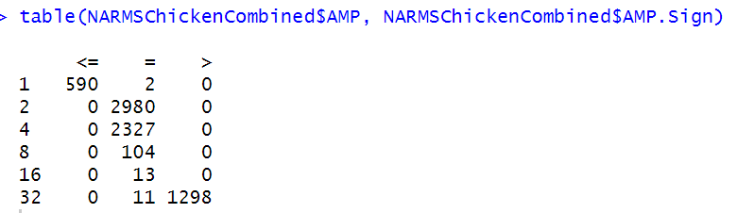
Data looks good
AMP Concentration Range Tested:
Same as cattle

Slide 17
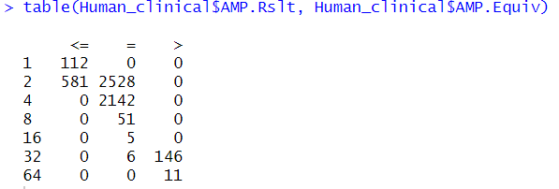
-remove <=2 isolates
-lump 64 isolates into 32 category

Slide 18
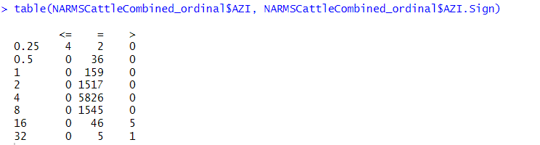
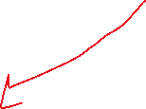



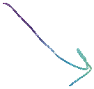
Started testing Azithromycin in 2011
Concentrations Tested by Year:
2015-2019: 0.25-32
2011-2015: 0.12-16
Use only isolates from 2015 onwards for AZI model? Toss just >16 isolates (only 5 of them)?
Change to 64 (double upper limit) to distinguish = 32 (was inhibited by 32) and >32 (still grew in 32)
Azithromycin

Slide 19
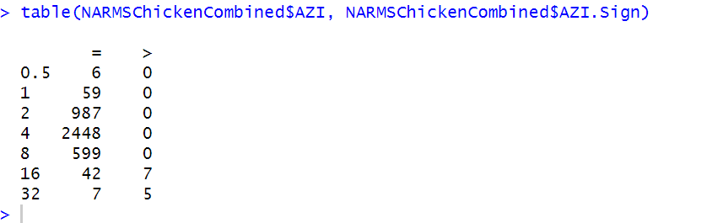


Started testing Azithromycin in 2011
Concentrations Tested by Year:
2015-2019: 0.25-32
2011-2015: 0.12-16
Toss just >16 isolates (7 of them)
Data looks good
AZI Concentration Range Tested:
Missing <=0.25. But values present fall into levels present in cattle data

Slide 20
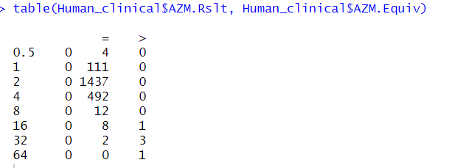
-remove >16 isolates
-lump 64 isolates into 32 category

Slide 21
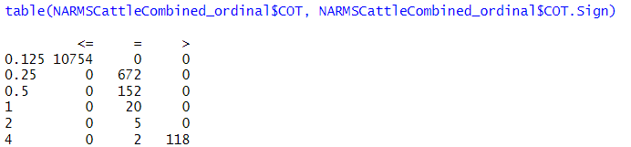


Data looks good
COT Concentration Range Tested:
0.125-4 (during entire range of dataset) (reports the trimethoprim MIC values)
Change to 8 (double upper limit) to distinguish =4 (was inhibited by 4) and >4 (still grew in 4)
Trimethoprim- Sulfamethoxazole

Slide 22
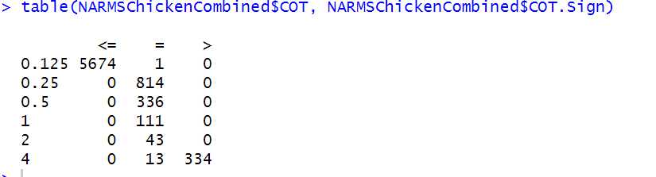
Data looks good
COT Concentration Range Tested:
Same as cattle

Slide 23
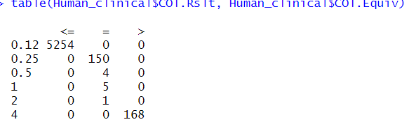
-make 0.12 into 0.125

Slide 24
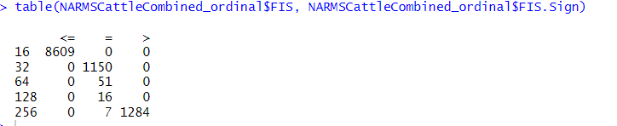


Data looks good
FIS Concentration Range Tested:
16-256 (during entire range of dataset)
Change to 512 (double upper limit) to distinguish =256 (was inhibited by 256) and >256 (still grew in 256)
Sulfisoxazole

Slide 25
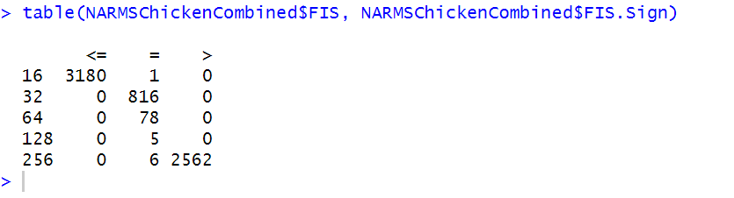
Data looks good
FIS Concentration Range Tested:
Same as cattle

Slide 26
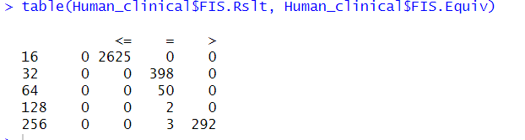

Slide 27
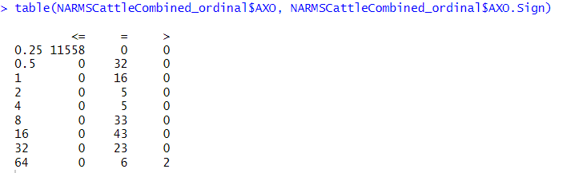


Data looks good
AXO Concentration Range Tested:
0.25-64 (during entire range of dataset)
Change to 128 (double upper limit) to distinguish =64 (was inhibited by 64) and >64 (still grew in 64)
Ceftriaxone

Slide 28
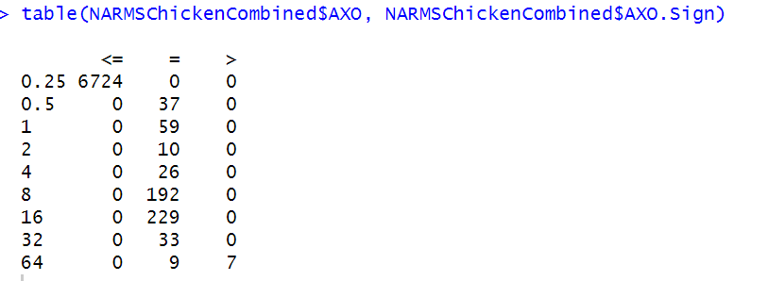
Data looks good
AXO Concentration Range Tested:
Same as cattle

Slide 29
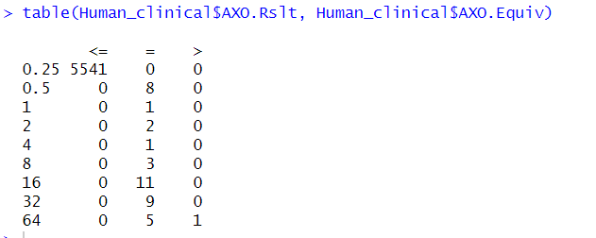

Slide 30
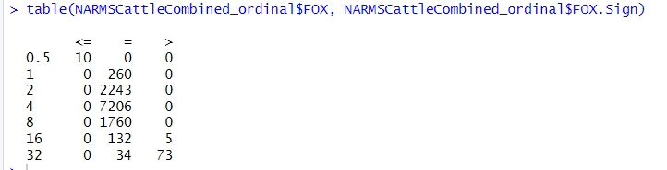

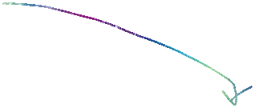
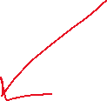


FOX Concentration Range Tested:
2002-2003: 0.5-16
2004-present:0.5-32
Use only isolates from 2004 onwards for FOX model? Toss just >16 isolates (only 5 of them)?
Change to 64 (double upper limit) to distinguish = 32 (was inhibited by 32) and >32 (still grew in 32)
Cefoxitin

Slide 31
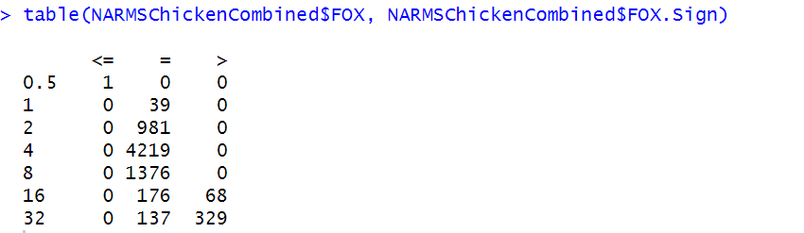
FOX Concentration Range Tested:
2002-2003: 0.5-16
2004-present:0.5-32
Toss just >16 isolates (68 of them)?
FOX Concentration Range Tested:
Same as cattle

Slide 32
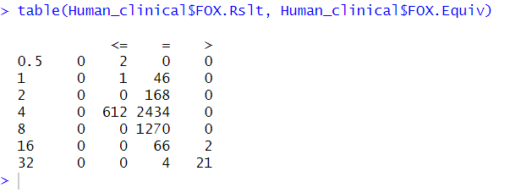
-drop <= 1,4 isolates
-drop >16 isolates

Slide 33
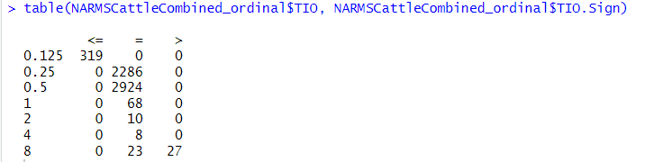
Data looks good
TIO Concentration Range Tested:
0.125-8 (during entire range of dataset)
Change to 16 (double upper limit) to distinguish =16 (was inhibited by 16) and >16 (still grew in 16)
Ceftiofur

Slide 34
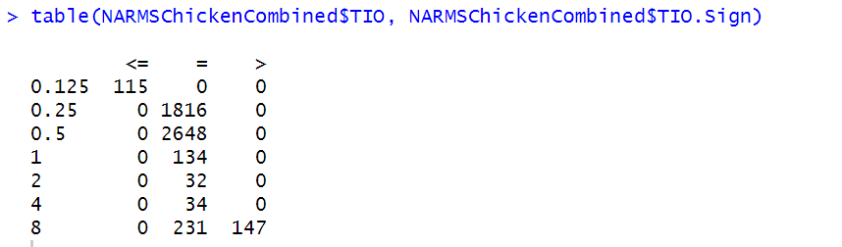
Data looks good
TIO Concentration Range Tested:
Same as cattle

Slide 35
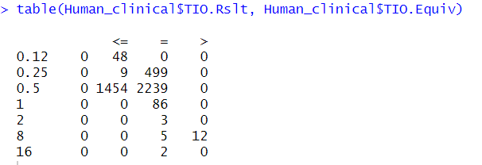
-make 0.12 into 0.125
-drop <= 0.25 and 0.5 isolates
-lump 16 isolates into 8 category

Slide 36
Skipping Cephalothin (CEP) because it stopped being tested after 2003, so there are only a few hundred isolates

Slide 37
Skipping Imipenem (IMI) because there are only 7 isolates

Slide 38
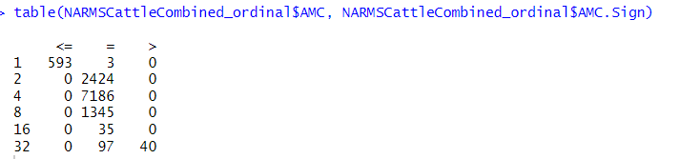


Same as <= sign category?
AMC Concentration Range Tested:
1-32 (during entire range of dataset)
Change to 64 (double upper limit) to distinguish = 32 (was inhibited by 32) and >32 (still grew in 32)
Amoxicillin-clavulanic acid

Slide 39
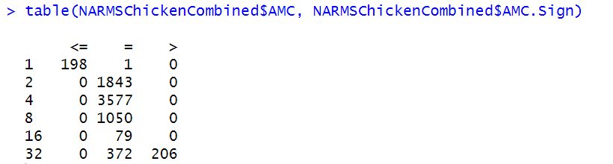
Data looks good
AMC Concentration Range Tested:
Same as cattle

Slide 40
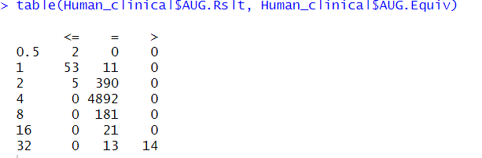
-lump 0.5 into 1
-remove 5 isolates with <= 2

Slide 41
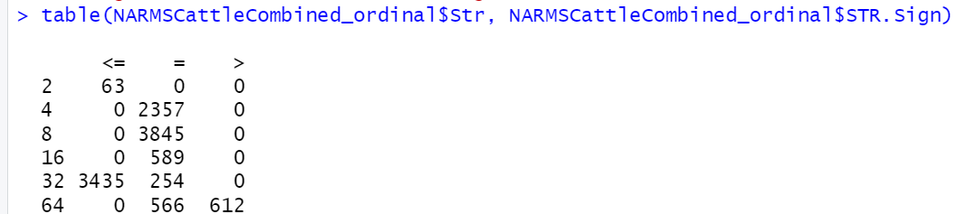


Str Concentration Range Tested By Year:
32-64 (2001-2013)
2-64 (2014-present)
Build model using only isolates from 2014 onwards in Str.RF.df dataframe to avoid this issue AND DON’T USE Str as a predictor variable
Change to 128 (double upper limit) to distinguish =64 (was inhibited by 64) and >64 (still grew in 64)
Streptomycin

Slide 42
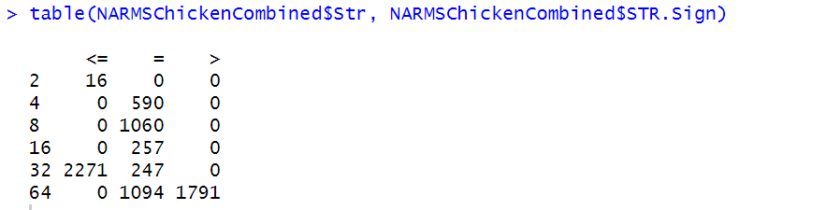


Test model using only isolates from 2014 onwards in Str.RF.df dataframe to avoid this issue

Slide 43
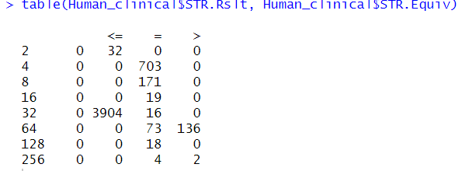
-lump 128 and 256 isolates into 64
-remove 3904 <= 32 isolates

Slide 44
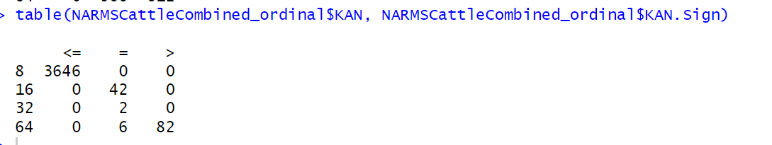
Data looks good
KAN Concentration Ranges Tested
8-64 (during entire range of dataset)
Change to 128 (double upper limit) to distinguish =64 (was inhibited by 64) and >64 (still grew in 64)
Kanamycin

Slide 45
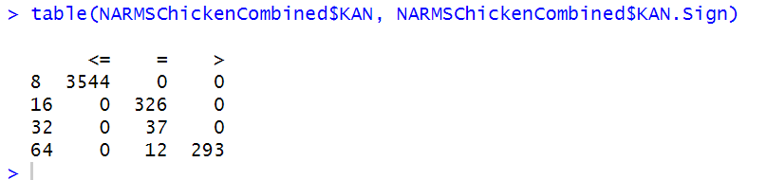
Data looks good
KAN Concentration Range Tested:
Same as cattle

Slide 46
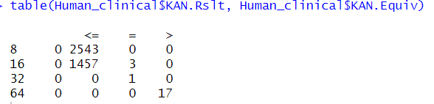
-remove 1457 <= 16 isolates

Slide 47
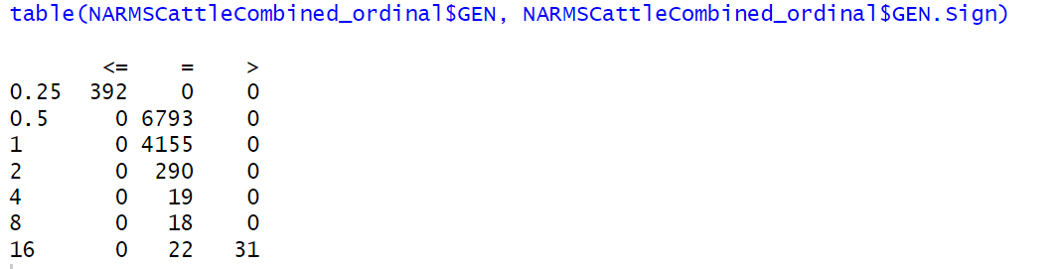
Data looks good
GEN Concentration Ranges Tested
0.25-16 (during entire range of dataset)
Change to 32 (double upper limit) to distinguish =16 (was inhibited by 16) and >16(still grew in 16)
Gentamycin

Slide 48
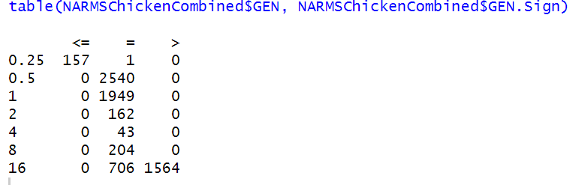
Data looks good
GEN Concentration Range Tested:
Same as cattle

Slide 49
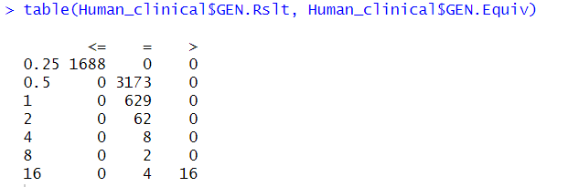

Slide 50
Apramycin (APR) not tested during time range of this dataset

Slide 51
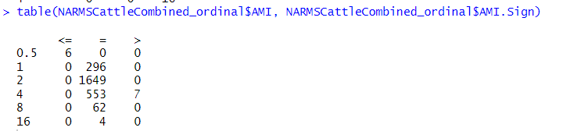



AMI Concentrations Tested by Year:
2002-2003: 0.5-4
2004-2010: 0.5-64
2011 onwards: stopped testing
Model was built using only isolates from 2004-2010 in AMI.RF.df dataframe to avoid this issue AND don’t use AMI as a predictor variable
Amikacin

Slide 52


AMI Concentrations Tested by Year:
2002-2003: 0.5-4
2004-2010: 0.5-64
2011 onwards: stopped testing
Model will be tested using only isolates from 2004-2010 in AMI.RF.df dataframe to avoid this issue

Slide 53

-drop 12 isolate?
-remove level 12
-remove <= 4 isolate

